Slide 1
Final project for the course Inteligent interfaces
SKELETON GIFT CHASE: SCHOOL OF SUPRISES
Developed by Oleh Petrov and Valeriia Rudenko

Slide 2

Welcome to Zombie Gift Chase: School of Surprises, our final project for the Intelligent Interfaces course. This Unity-based game promises a unique and thrilling experience set in a school environment, where surprises await at every turn.

Slide 3

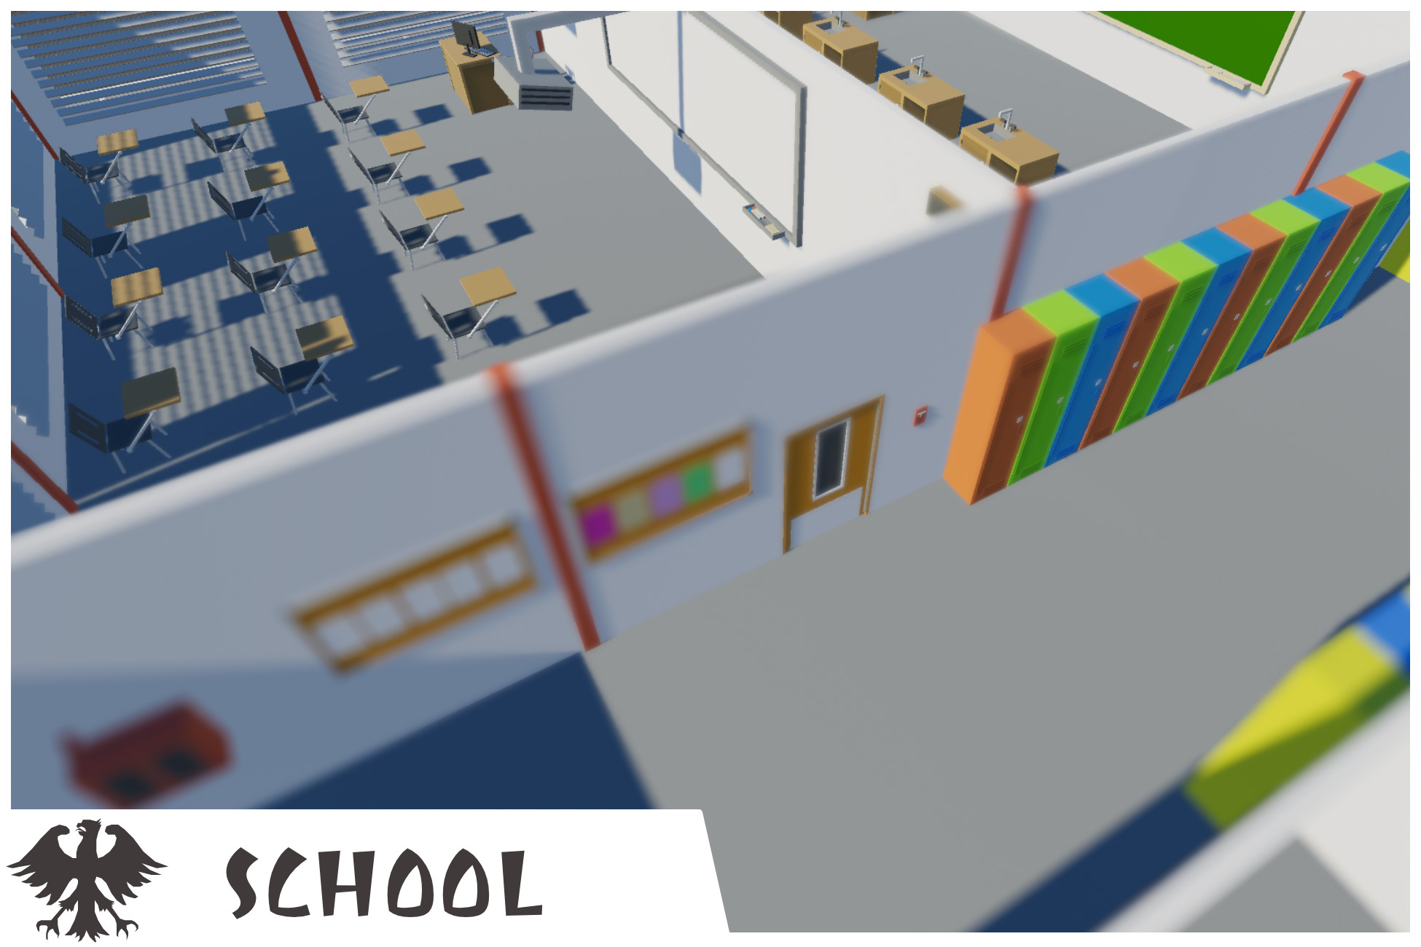

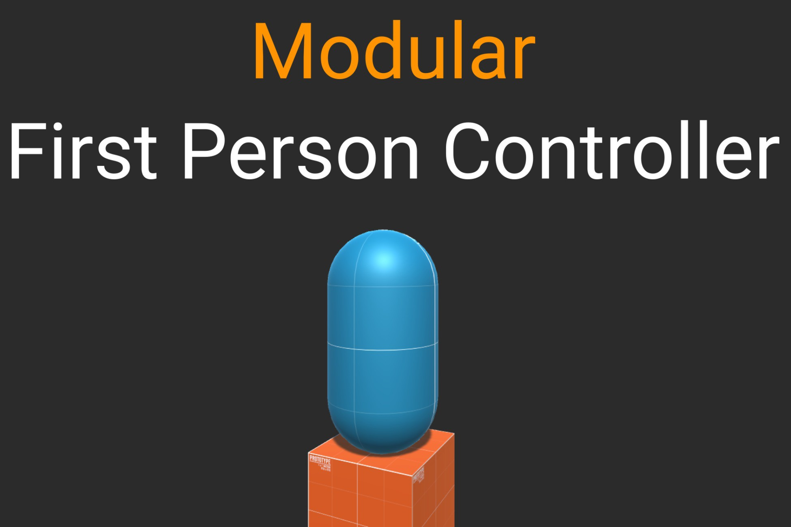
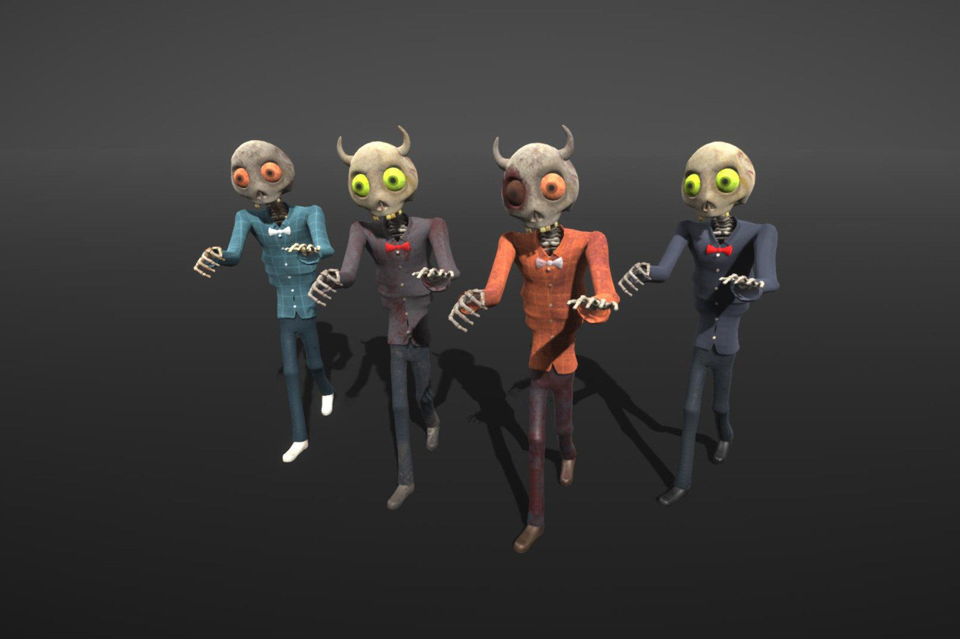
TECHNICAL DETAILS
Unity version: [2022.3.15f1]
Used assets:
Rocky Hills environment -Light pack
School assets
Skybox series Free
Modular First Person Controller
Skeleton Ghost

Slide 4
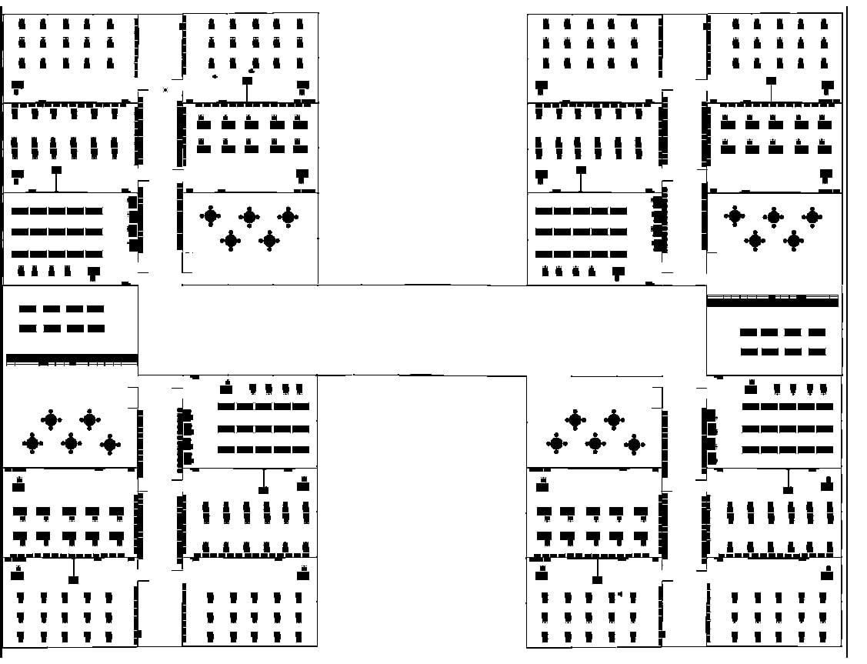
PRELIMINARY PROTOTYPE OF THE SCHOOL

Slide 5

MENU

Slide 6
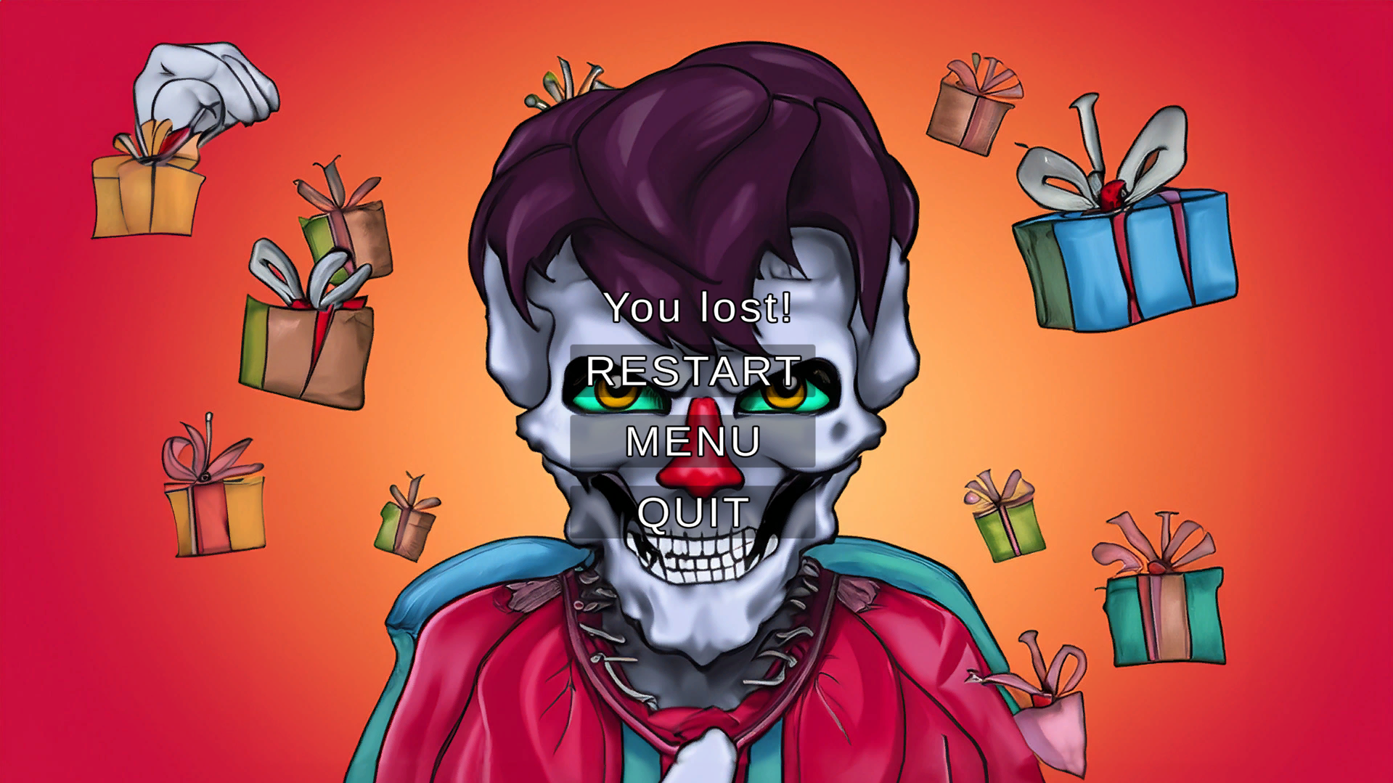
MENU IF YOU LOSE

Slide 7
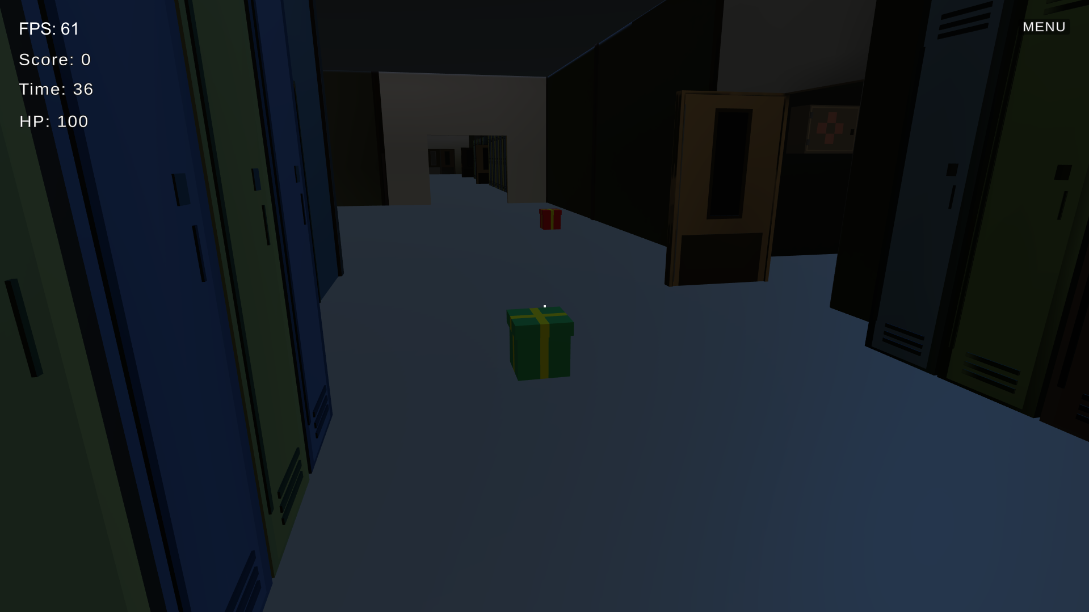
SCHOOL AND GIFTS

Slide 8
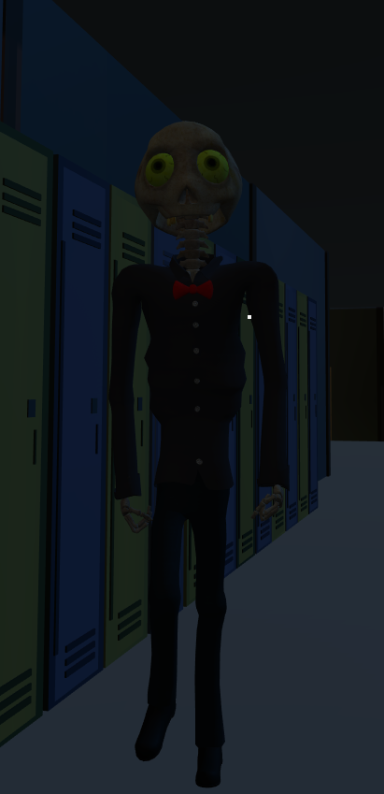
DAY AND NIGHT MODES
Day Mode:
Collect presents scattered throughout the school.
Presents dynamically generate, creating a continuous challenge for players.
A counter keeps track of the collected presents.
Night Mode:
Brace yourself for a spine-chilling experience as a relentless skeleton hunts you down while you attempt to collect presents. You start with 100 lives, and the game ends if you lose them all.

Slide 9
FEATURES P.1
Skeleton Animation and Sound:
animations for idle and walking
When the skeleton approaches the player, an attack animation plays upon contact.
A distinct sound accompanies the skeleton's attack, intensifying the gaming experience.
Player Iinteractions:
When the player collects gifts, a sound effect is triggered, providing audio feedback for successful interactions.
Audio Feedback:
Experience the game's intensity through immersive sound effects.
Impactful sounds accompany the skeleton's attacks.
Timer:
Keep track of your progress with a timer that records the time spent in both day and night modes.

Slide 10
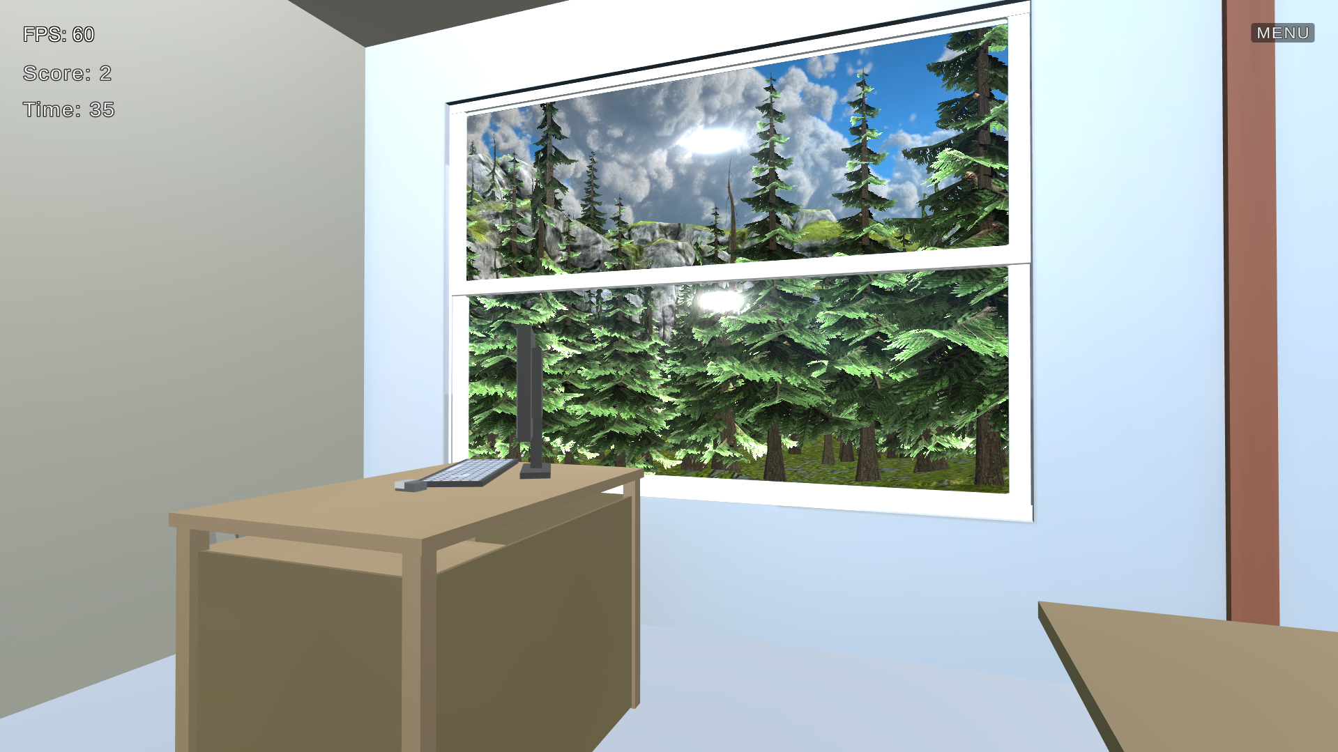
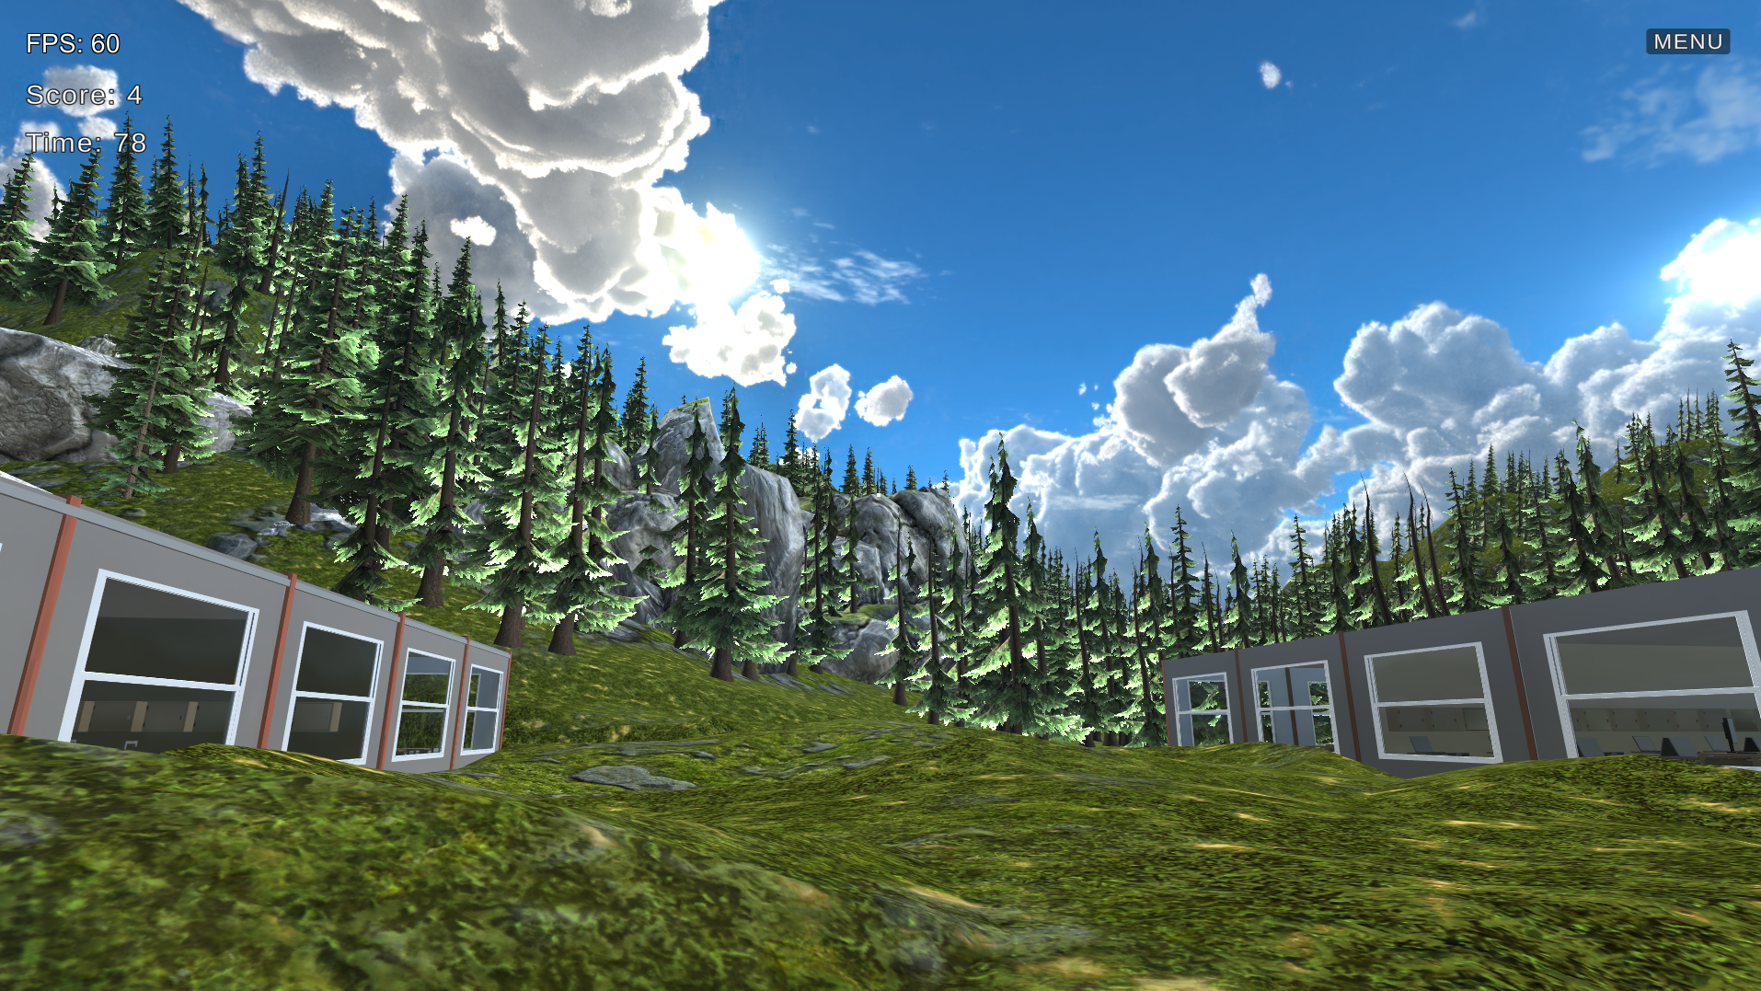
VIEW FROM A SCHOOL WINDOW

Slide 11
Real-Time Camera Feed: Activate your in-game camera with the press of a button (O), allowing real-time self-view on interactive boards. Deactivate the camera with another button (P). Voice Recording: Record your voice by pressing 'R' near the interactive boards, enabling message sharing and unique in-game experiences. Hold down the 'L' key to activate voice recognition, adding an extra layer of interactivity. Sensors: FPS Sensor Score Sensor Time Sensor HP Sensor
FEATURES P.2

Slide 12
VOICE-ACTIVATED SKELETON BEHAVIOR
Voice Command: "STOP":
In response to the voice command "STOP," the skeleton stops pursuing the player.
The skeleton remains stationary, visibly frustrated, and taps its foot in place.
Voice Command: "MOVE":
In response to the voice command "MOVE," the skeleton resumes its pursuit, following the player's movements.

Slide 13
Thank you for attention! Now we will show you execution of this game.

